Slide 1
Reading System for the Blind
Project by Binayak Ghosh, Ishita Banerjee, Roshwin Sengupta
Department of Electronics and Communication
Institute of Engineering & Management

Slide 2
ACKNOWLEDGEMENT
We would like to extend our gratitude to our Principal Dr. Amlyan Kusum Nayak, our Project Mentor Prof. Biswajoy Chatterjee and our entire ECE Department faculty for giving us the opportunity to work on this project and for helping us out with their precious advice at every step of this project.
Furthermore, we are grateful to the Innovation & Entrepreneurship Development Cell, Department of Science & technology, Govt. Of India for funding our project.

Slide 3
ABSTRACT
This system aims to develop cost-effective assistive technologies to provide blind people with a greater degree of independence in their daily activities.
Our research and development of the original prototype comprises of an OCR-based solution comprising a combination of off-the-shelf components, such as a high-resolution webcam, an in-built Optical Recognition Software and a Braille code enabled hand glove.

Slide 4
CONTENTS
Introduction
Driving Principle for the Design
Overview of Existing Reading Devices for the Blind
Objectives and Design Consideration
Text Detection and Extraction from Distant Scenes
Optical Code Recognition
Developmental Stages
Micro-Controller Circuit Board
Braille Glove
Results
Conclusion and Further Improvements
At a Glance

Slide 5
INTRODUCTION
This project was conceived keeping in mind the day to day struggles such as reading from blackboards, signboards, grocery shopping, reading bus-numbers from the distance, etc faced by the blind and visually impaired people.
According to a recent survey by a national organisation for ophthalmologists India accounts for 20% of the total blind population of the world, with 7.8 million visually impaired out of the 39 million across the globe. India is now home to the world's largest number of blind people.
285 million people are estimated to be visually impaired worldwide: 39 million are blind and 246 have low vision.
About 65 % of all people who are visually impaired are aged 50 and older, while this age group comprises about 20 % of the world's population.

Slide 6
Globally the major causes of visual impairment are:
Uncorrected refractive errors (myopia, hyperopia or astigmatism), 43 %
Unoperated cataract, 33%
Glaucoma, 2%.
A significant number of individuals who are legally blind find large print or audio texts helpful, while only 8-10% use Braille as a reading medium.
The scope of the initial prototype of our device was to assist the visually impaired with the task of reading text from a distance.
Our prototype design consists of a high-resolution camera, an in-built processor capable of converting the detected text into braille code, and a Braille Glove to notify the user of the read text.

Slide 7
DRIVING PRINCIPLE FOR THE DESIGN
The main reasons for choosing this project are:
Independence in daily activities is the topmost priority for blind people.
Inserting assistive enhancements into a blind person’s shoes or cane adds more weight influencing its torque and usage adversely.
Products targeted specifically at blind people tend to be more expensive.
Our project aims at removing such constraints by helping the visually challenged to read independently without restricting his/her movements. It also uses COTS (commercial off-the-shelf technologies) ensuring cost-effectiveness of the product.

Slide 8
OVERVIEW OF EXISTING READING DEVICES FOR THE BLIND
Many reading devices for visually-impaired people are already available and quite popular too. These devices make use of a scanner which scans the entire document and subsequently the in-built optical recognition system extracts the text from the page.
Two front runners are Top-Braille and Trinetra.
Top-Braille: Allows a visually impaired user to instantaneously read any printed text. it is a concentrate of electronic components and high-tech software: high definition lens, Character recognition software, Braille matrix fitted with a unique navigation system, voice synthesis software.
Trinetra: Allows a cost-effective, independent shopping experience for the blind. The system consists of smart-phone, a Bluetooth wireless headset, Baracoda’s IDBlue RFID-scanning pen, Baracoda’s barcode-scanning BaracodaPencil, generic low-frequency RFID tags and a desktop computer acting as a remote server for specific operations.

Slide 9
OBJECTIVES AND DESIGN CONSIDERATION
The technical objective of this device, in the context of reading from distance, is to allow a cost-effective, independent reading experience for the blind. We aimed to use commercial off-the-shelf (COTS) components. Our prototype incorporates the following:
A high resolution camera.
A laptop or a smart phone.
An OCR software.
A microcontroller board.
Braille glove.

Slide 10
TEXT DETECTION & EXTRACTION FROM DISTANT SCENES
The detection and recognition of text from natural scene images constitute one of the main tasks that need to be fulfilled in order to proceed with our project.
A global method like the Otsu’s technique is not quite suitable for camera captured images, since it often leads to loss of textual information against the background.
The camera used for this purpose was the Microsoft LifeCam Studio Webcam.
For text detection from the image, the open source Optical Character Recognition engine, Abbyy FineReader was used. The pre-processed image was then fed into the OCR engine and the detected text was displayed into a .txt file or a .doc file.

Slide 11
OPTICAL CODE RECOGNITION(OCR)
Optical Character Recognition, or OCR, is a technology that enables one to convert different types of documents or images captured by a digital camera into editable and searchable data.
ABBYY FineReader is an optical character recognition (OCR) software that works with text conversion and creates editable, searchable files and e-books from scans of paper documents, PDFs and digital photographs.
Its salient features:
Convert scans & PDFs into searchable files.
One-click OCR software.
Convert documents with unmatched recognition accuracy, virtually eliminating retyping.

Slide 12
The three basic principles that allow humans to recognize objects are:
Integrity
Purposefulness
Adaptability (IPA).
Let’s take a look on how FineReader OCR recognizes text.
The program analyzes the structure of document image.
It divides the page into elements such as blocks of texts, tables, images, etc.
The lines are divided into words and then - into characters.
The program compares the characters with a set of pattern images.
It advances numerous hypotheses about what this character is.
After processing huge number of such probabilistic hypotheses, the program finally takes the decision, presenting the recognized text.

Slide 13
Using ABBYY FineReader OCR is easy. The process generally consists of three stages:
Open (Scan) the document
Recognize it
Save in a convenient format
The entire process of data conversion from original paper document, image or PDF takes less than a minute, and the final recognized document looks just like the original.
Advanced, powerful OCR software allows one to save a lot of time and effort when creating, processing and repurposing various documents.

Slide 14
DEVELOPMENT STAGES
The entire project has been developed in two stages:
Using a Computer/Laptop.
Using a Smart Phone.
Using laptop: At first the project was developed using laptop as the processing medium. The components exclusively needed for developing using a laptop are:
Webcam or a digital camera: A digital camera with 5-megapixel resolution or higher is used equipped with Flash disable mode, optical zoom, an anti-shake feature and autofocus.
ABBYY Screenshot Reader: The Screenshot Reader is an advanced version of ABBYY Finereader. With ABBYY Screenshot Reader one can take Image Screenshots or Text Screenshots.

Slide 15
Image Screenshots: Easily create screenshots and save them as images, only selected area on the screen, a complete window (print screen) or his entire desktop can be captured.
Text Screenshots: If one wants to grab some text from an image file, Web site, presentation, or PDF he can quickly turn text areas into truly editable text that he can paste directly into an open application, edit or save as Microsoft Word or Excel documents. Screenshot Reader will convert the image of the screenshot into text.
c. Python Programming: Python is a widely used general-purpose, high-level programming language. In this project Python is used with the purpose of reading text from Clipboard and then setting up the serial communication with the microcontroller board, which in this case is Arduino.
Using Smartphone: The entire project was shifted to smart phone from laptop primarily due to portability issues. The components used are:
ABBYY Mobile OCR: This powerful software development kit (SDK) enables images and photographs to be transformed into searchable and editable document formats and supports all of the most popular mobile platforms and devices.

Slide 16
Steps for the app:
Step 1: Image import and processing.
Step 2: Document Analysis.
Step 3: OCR – includes the options of Business Card Processing or Barcode Recognition.
Step 4: Result Processing.
b. Android app: We need to establish a serial communication between the Android environment and the Arduino prototyping board. We need to send the detected text character by character to the Arduino for it to process. For that purpose, we designed a 'thread', which reads the entire text and detects and prints character wise, using a delay of 5 seconds. To establish the serial communication between the Android device and the Arduino board, we designed a .apk android file which sends the data from the Android device to the Arduino using a USB cable.

Slide 17
MICROCONTROLLER CIRCUIT BOARD
An effective user-interface support for the architecture is important, as an embedded operating system would provide structure and low-level functionality. This is the reason the Arduino Uno microcontroller development board was chosen.
Arduino: Arduino Uno is a microcontroller board based on the ATmega328. It has 14 digital input /output pins, 6 analog inputs, a 16 MHz ceramic resonator, a USB connection, a power jack, an ICSP header, and a reset button.
Memory: Primary memory is 32 KB. It also has 2 KB of SRAM and 1 KB of EEPROM.
Communication: The ATmega328 provides UART TTL (5V) serial communication, which is available on digital pins 0 (RX) and 1 (TX).
Programming: The Arduino Uno can be programmed with the Arduino software .

Slide 18
The ATmega328 on the Arduino Uno comes preburned with a bootloader that allows one to upload new code to it without the use of an external hardware programmer. It communicates using the original STK500 protocol.
Steps:
The analog serial pins are at first assigned as six output pins.
The baud rate is specified.
For each character – all the alphabetic, numeric and a few alphanumeric, specific set of output pins are high. Here the Braille convention is followed.
The program is terminated.

Slide 19
BRAILLE GLOVE
All over the world, persons with visual handicaps have used Braille as the primary means to reading information.
Standard Braille is an approach to creating documents which could be read through touch. This is accomplished through the concept of a Braille cell consisting of raised dots on thick sheet of paper.
A cell consists of six dots arranged in the form of a rectangular grid of two dots horizontally and three dots vertically. With six dots arranged this way, one can obtain sixty three different patterns of dots. A visually Handicapped person is taught Braille by training him or her in discerning the cells by touch, accomplished through his or her fingertips.

Slide 20
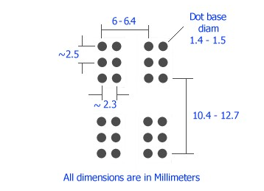
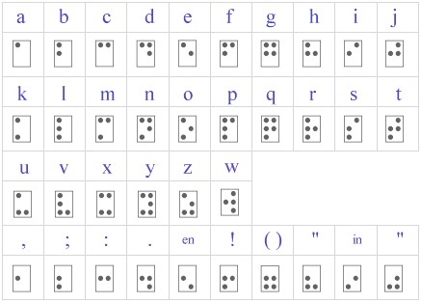
Braille cell: A printed sheet of Braille normally contains upwards of twenty five rows of text with forty cells in each row.
The six dots forming the cell permit sixty three different patterns of dot arrangements.
Standard English Braille: The sixty three cells will correspond to a letter of the Roman alphabet, or a punctuation mark.

Slide 21
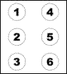
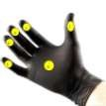
Basic idea behind Braille glove: The six dots forming the cell permit sixty three different patterns of dot arrangements. The combination of the dots correspond to the alphabets, numbers and special symbols of the English language.
The Braille glove contains six vibration motors, of which five are fixed in the five fingers and one on the centre of the palm.
After the OCR system has deciphered the text from camera images, each character of the text is then converted into the corresponding Braille code and the relevant vibrator motors are activated.

Slide 22
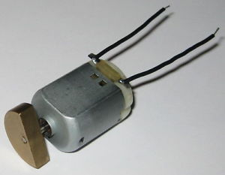
Motors: The main component in Braille glove is vibration motor. It is configured in two basic varieties i.e coin (or flat) and cylinder (or bar).
Cylinder type motors are simple brush motors with a traditional axial design. The eccentric movement of the weight attached to the rotor provides vibration during operation. In Braille glove it is best suited in finger positions.

Slide 23
RESULTS
Initial test results for the pre-processing and optical character recognition indicate an average of 95% efficiency. The generation of the Braille code as well as the vibratory feedback have provided fruitful outcomes.
However, the latency of the entire process is quite a bit on the higher side. We expect that the results will enable us to further do research on this subject and help in reducing the latency.

Slide 24
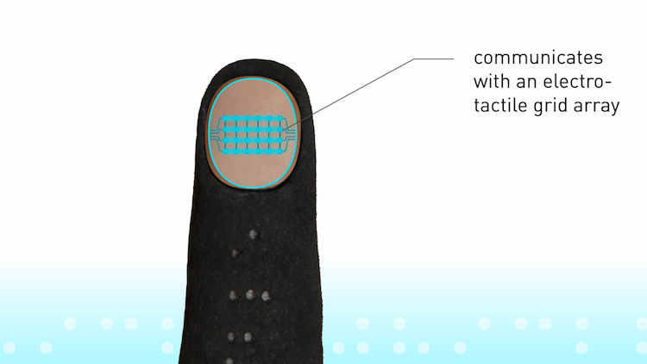
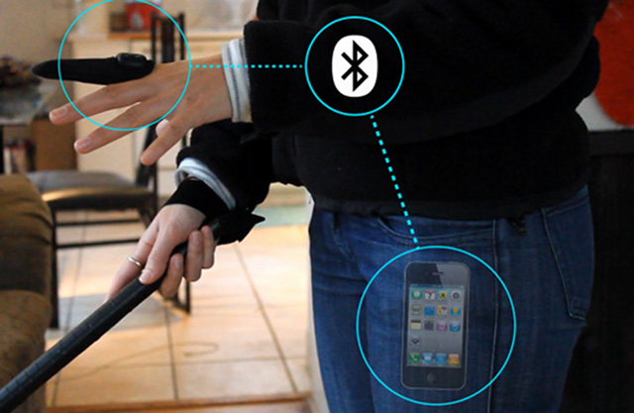
CONCLUSION & FURTHER IMPROVEMENTS
This system enables the visually-impaired users to read text not only from books and papers, but also from billboards and signs at a greater distance.
The use of everyday objects in the development of this device will also reduce the cost of manufacturing the device, thus making it available to people at reasonable price.
Although the results are promising, the system requires further tests and improvements. For further development, we intend to design a customised electro-tactile grid-array to provide Braille pulse patterns to the finger-tip. We intend to develop a thimble like wearable device for the finger, with an electro-tactile grid array on the finger tip.

Slide 25
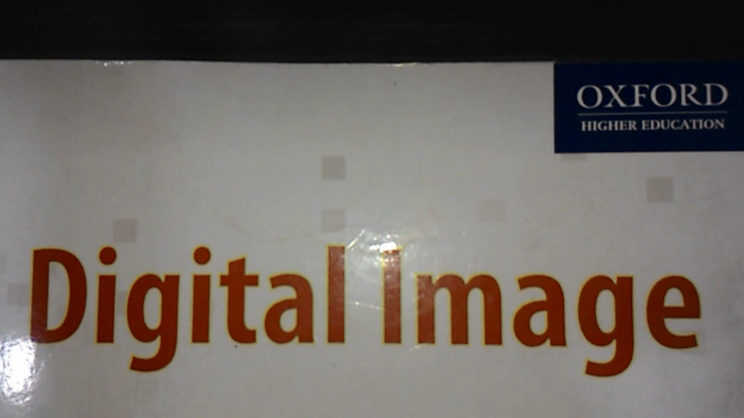
AT A GLANCE
Step 1: The picture of a distant object with text is captured using a camera.

Slide 26
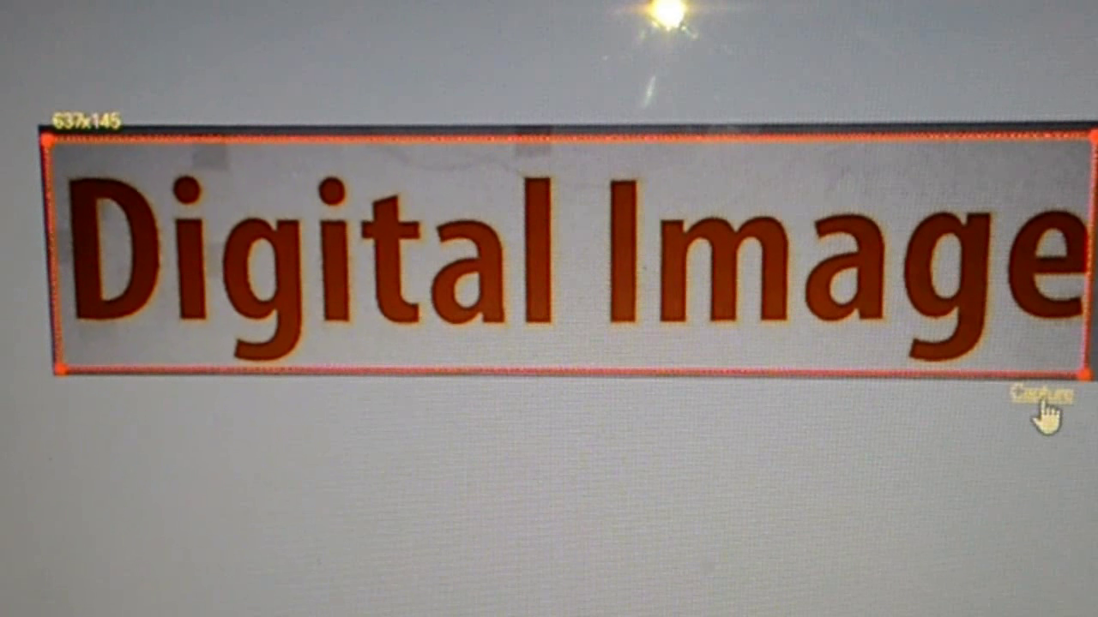
Step 2: The screenshot of the picture is taken by ABBYY Screenshot Reader.

Slide 27
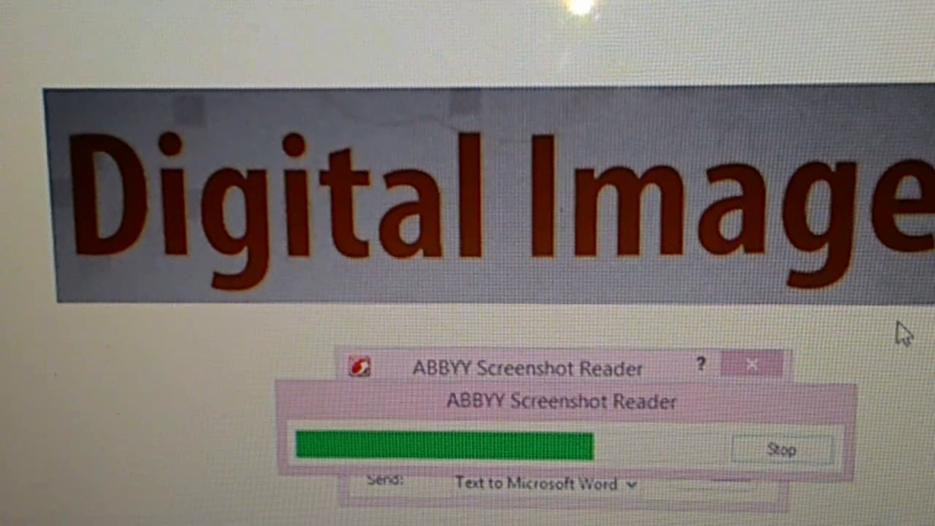
Step 3: The ABBYY Screenshot Reader processes the image.

Slide 28
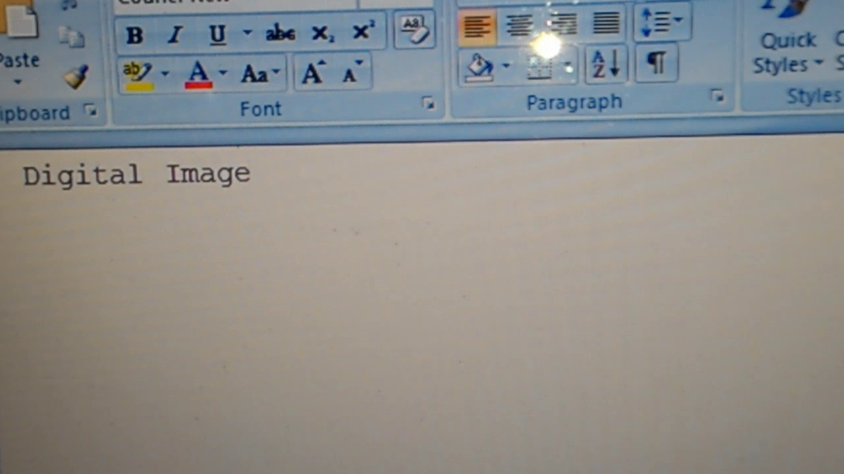
Step 4: The text is detected by the OCR software

Slide 29
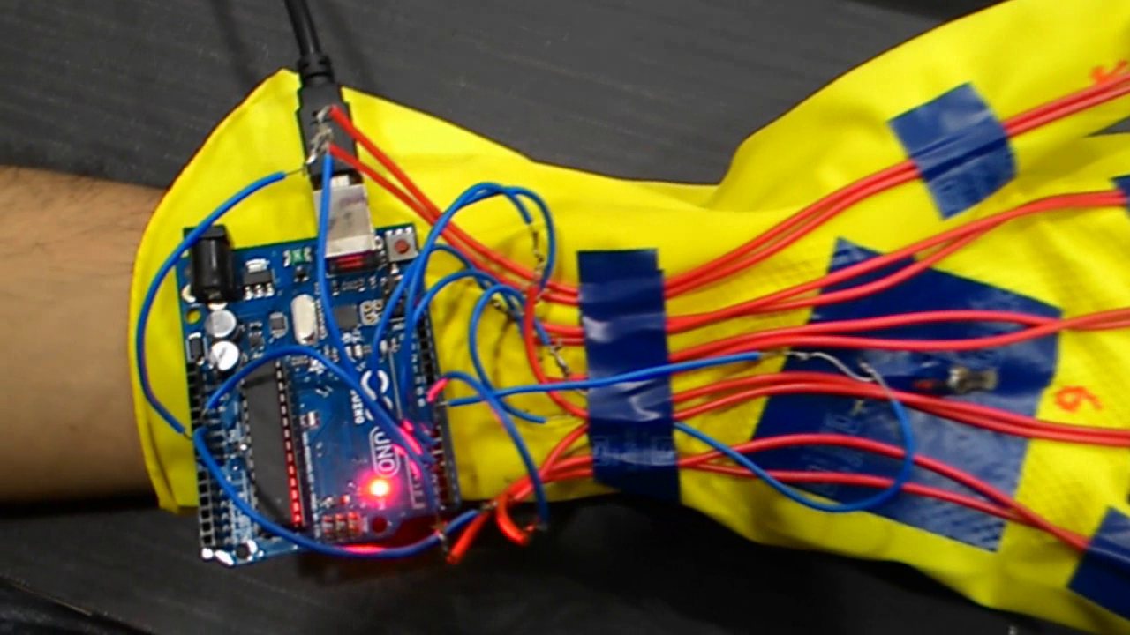
Step 5: The text is then fed to Arduino, character wise.

Slide 30
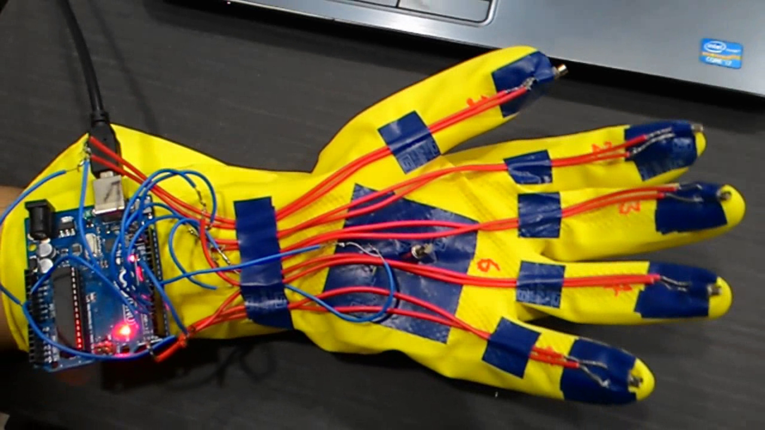
Step 6: The vibratory motors vibrate according to the characters detected following the standard Braille code and the user can identify the characters.

Slide 31
THANK YOU

